Slide 1
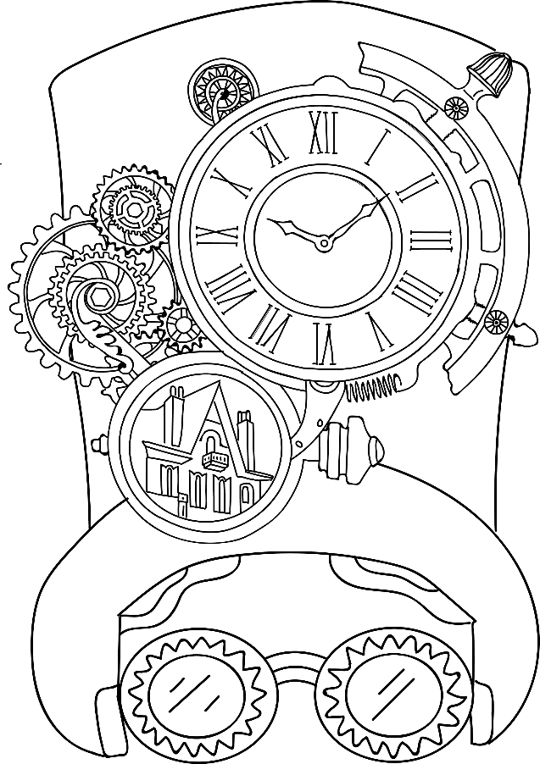
Victorian Time Traveler
Technology - Listening Activity

Slide 2
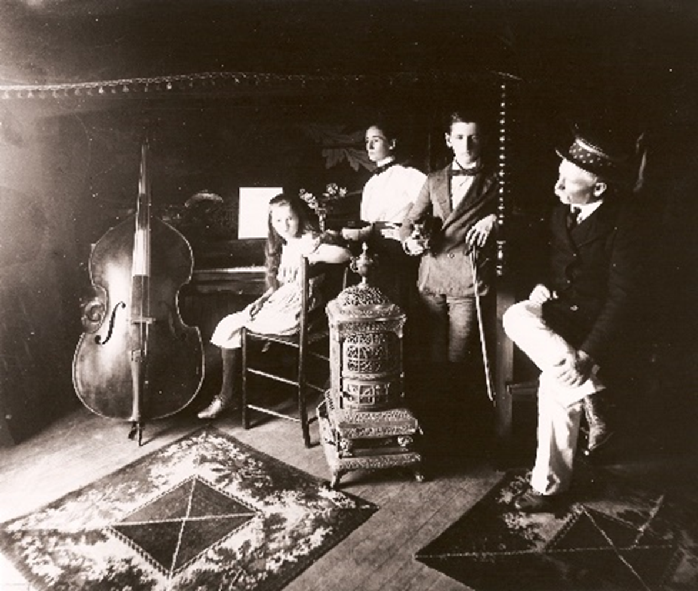
In this activity, we’ll use the latest recording technology (digital files, or .wav), to identify and enjoy popular instruments and music from the Victorian era.
The Körner family in the orchestra pit of Cupid’s Park Theatre on the 3rd floor of Körner’s Folly

Slide 3
Let’s play a game…
The Körner children, Gilmer and Doré, were raised to play music. Their mother Polly Alice taught them it was very important to work hard in order to be successful, so she had them practice for two hours every day before breakfast!
The family played several instruments, including the piano, the violin, and the cello. Click through to the next slide to see if you can recognize the sound of these instruments…

Slide 4
Can you name the instrument being played?
(Answer on next slide)

Slide 5
If you guessed violin, you’re correct!

Slide 6
Let’s play again! How about this instrument?

Slide 7
Did you guess piano? Great job!

Slide 8
OK, let’s play one more time…

Slide 9
If you guessed cello, you’re right!

Slide 10
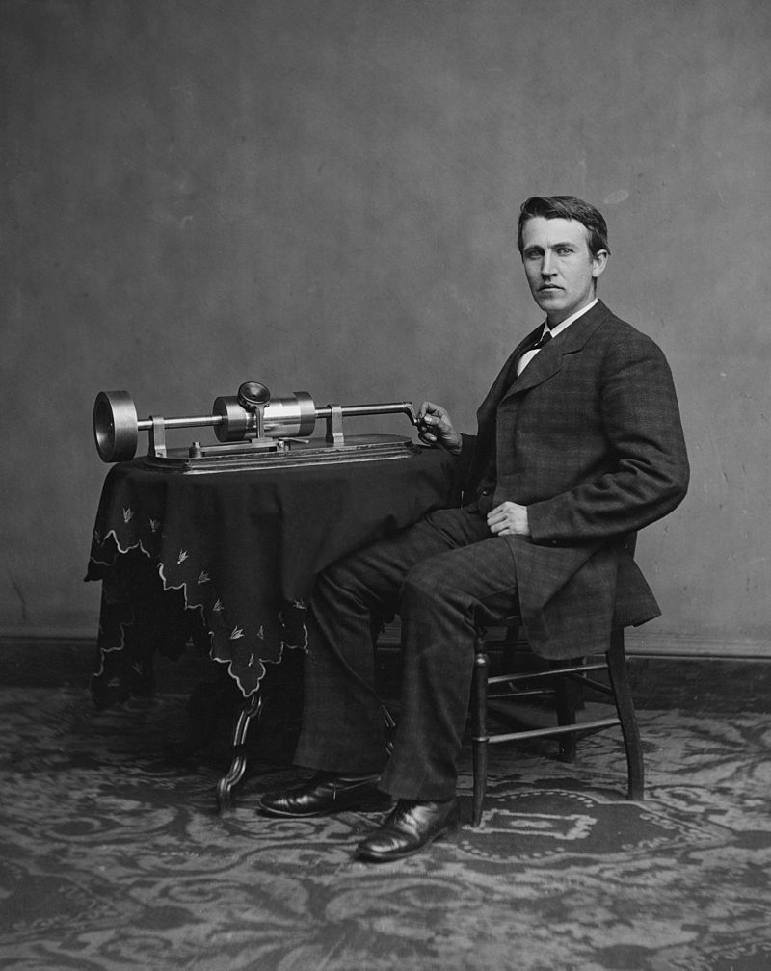
The invention of the phonograph in Victorian era was revolutionary – for the first time, songs could be recorded for listening later.
Thomas Edison with the second version of his phonograph

Slide 11
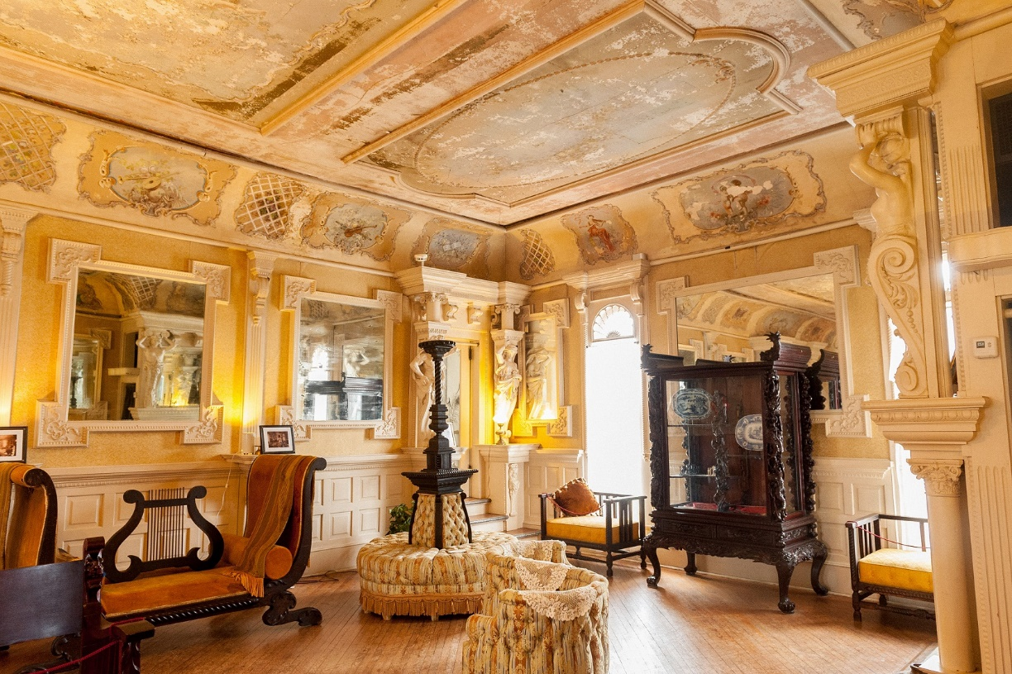
Here in the Reception Room at Körner’s Folly, the family would have entertained their guests with records from the Victrola phonograph.

Slide 12
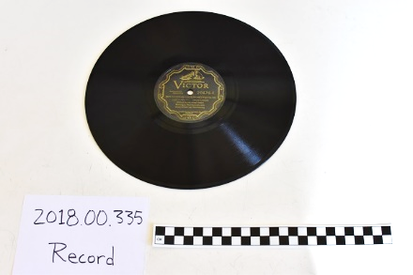
The original Victrola and record from the Körner’s Folly Collection

Slide 13
The Romantic Composers
From roughly 1800 – 1910, this period was marked by composers who created music that was much more emotional and dramatic than the Classical period that came before it. Reacting to the Classical emphasis on rational explanations of the world, the Romantics embraced mystery, wonder, and enchantment.
Romantic composers such as Antonín Dvořák, Franz Liszt, and Adrien-François Servais were very popular with live audiences as well as purchasers of recorded music. The Körner family owned a recording of Fritz Keisler’s performance of Dvořák’s “Humoresque Number 7” that still remains in the organization’s collection today.
Let’s learn about and listen to some of the Körner’s favorite composers!

Slide 14
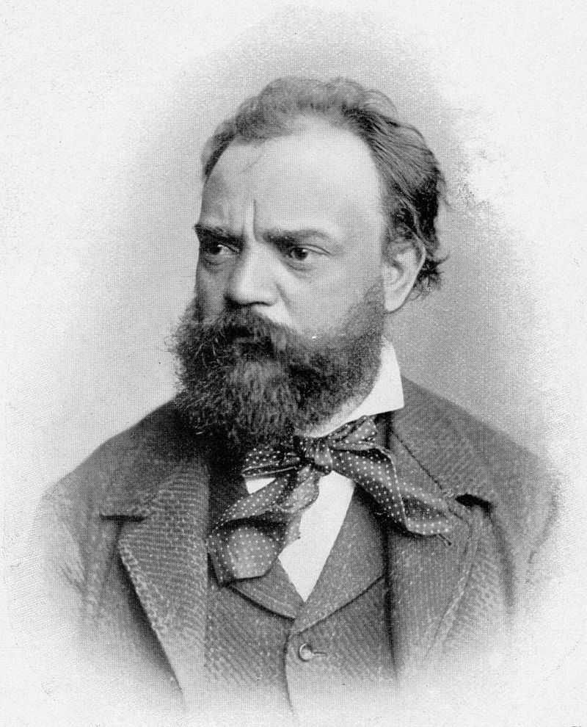
Antonin Dvořák (1841 – 1904) (Pronounced “d’vorjjack”)
A famous Czech composer, he began playing organ, violin, and piano at age 6. As he grew older, he performed all over Europe and Russia, eventually moving to New York City to serve as the director of the National Conservatory for the Arts.
He created music based on the folk music of the people of Moravia and Bohemia (then part of the Austrian Empire).

Slide 15
Dvořák - Humoresque, Op. 101, No. 7 for Cello and Piano (click link above if embedded video does not auto-play due to browser requirements)

Slide 16
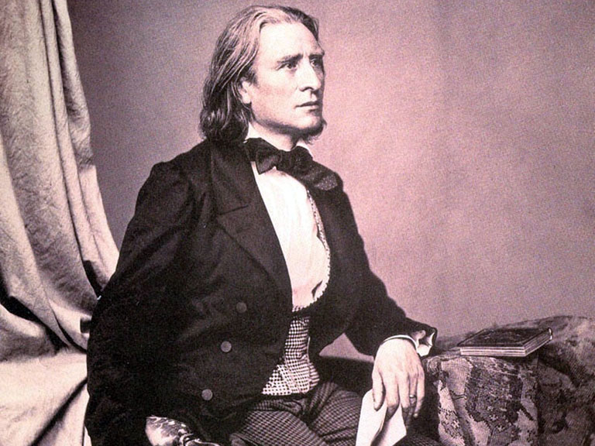
Franz Liszt (1811 – 1886) (Pronounced “list”)
Thought to be one of the greatest piano players of all time, Franz Liszt learned from his father how to play the piano, violin, cello, and guitar.
As he grew older, he started arranging music for large orchestras, piano duets, and piano trios. A Hungarian, he wrote music that celebrated his country and elevated folk songs and themes.

Slide 17
Valentina Lisitsa plays Liszt's Hungarian Rhapsody No. 2 (click link above if embedded video does not auto-play due to browser requirements)

Slide 18
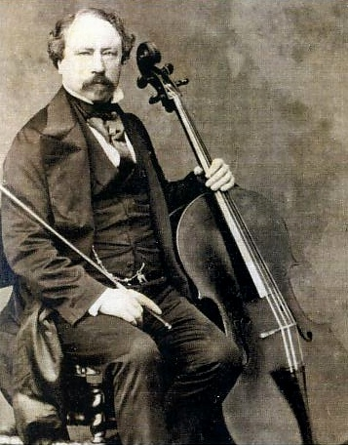
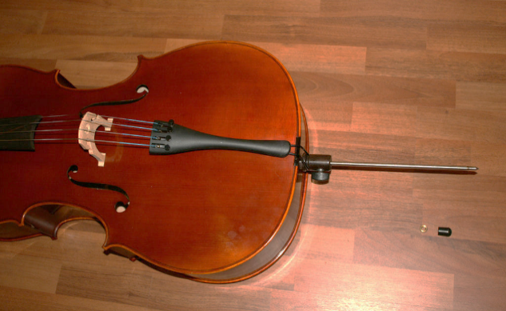
Adrien-François Servais (1807 – 1866)
(Pronounced “Sir-vase”)
Born in Halle, Belgium, he was originally a violinist before switching to the cello. Known for his virtuosity and vibrato, he was gifted a Stradivarius cello which was so large, he had to use an endpin to help support the instrument’s weight.
He was a founder of the Modern Cellistic Schools of Paris and Madrid, and wrote numerous concertos, duets, and orchestral music featuring his favorite instrument.
Cello end pin

Slide 19
A. F. Servais: Cello Concerto in A Minor op. posth., 1st movement (click link above if embedded video does not auto-play due to browser requirements)

Slide 20
Reflection – Writing or Discussion
Which one of the instruments would you like to play most?
Which composer did you like the most, and why?
Which composer did you like the least, and why?
Have you ever performed a musical piece? If so, what was it? On which instrument? What was that experience like?

Slide 21
The End

